Slide 1

Rockbuster Stealth LLC, Data Analysis Project
Jakov Horvat, 27.05.2023

Slide 2

Introduction
Rockbuster stealth LLC is the movie rental company that plans to launch its online video rental service to compete with services such as Netflix, Amazon Prime, etc.
The company requires an analysis to answer the questions about its market
Insights of this analysis will be used in the new streaming service launch strategy

Slide 3
General Data About Movies from the Database
EARLIEST RELEASE YEAR OF A MOVIE:
2006
LATEST RELEASE YEAR OF A MOVIE:
2006
AVERAGE RELEASE YEAR OF A MOVIE:
2006
MINIMAL RENTAL DURATION OF A MOVIE:
3 DAYS
MAXIMAL RENTAL DURATION OF A MOVIE:
3 DAYS
AVERAGE RENTAL DURATION OF A MOVIE:
4.99 DAYS
MOST FREQUENT MPAA RATING AMONG MOVIES:
PG-13
MINIMAL RENTAL RATE OF A MOVIE:
0.99
MAXIMAL RENTAL RATE OF A MOVIE:
4.99
AVERAGE RENTAL RATE OF A MOVIE:
2.98
MINIMAL LENGTH OF A MOVIE:
46 min
MAXIMAL LENGTH OF A MOVIE:
185 min
AVERAGE LENGTH OF A MOVIE:
115.27 min
MINIMAL REPLACEMENT COST OF A MOVIE: 9.99
MAXIMAL REPLACEMENT COST OF A MOVIE: 29.99
AVERAGE REPLACEMENT COST OF A MOVIE: 19.98

Slide 4
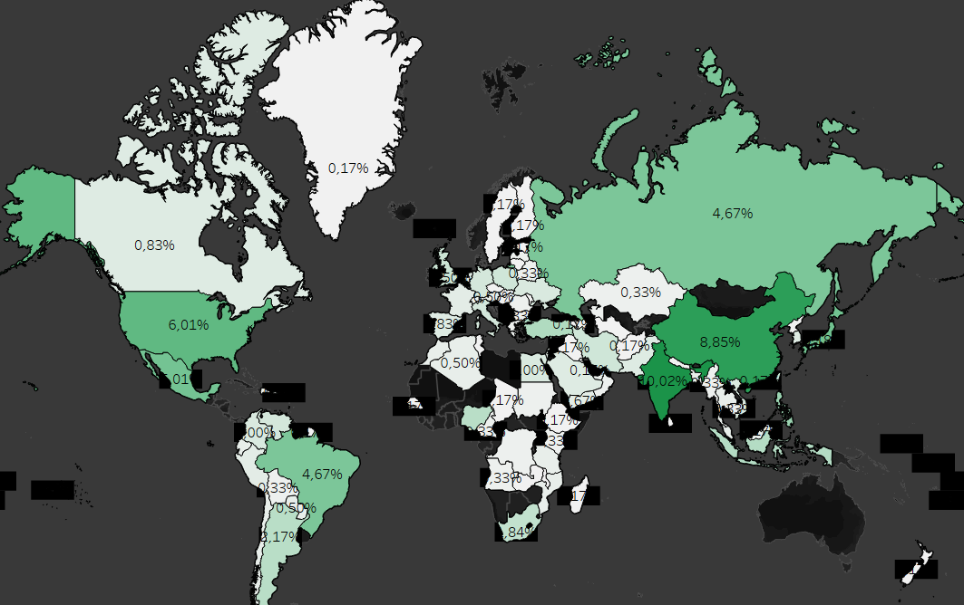
Which countries are Rockbuster customers based in?
India with the largest share of 10.02%.

Slide 5
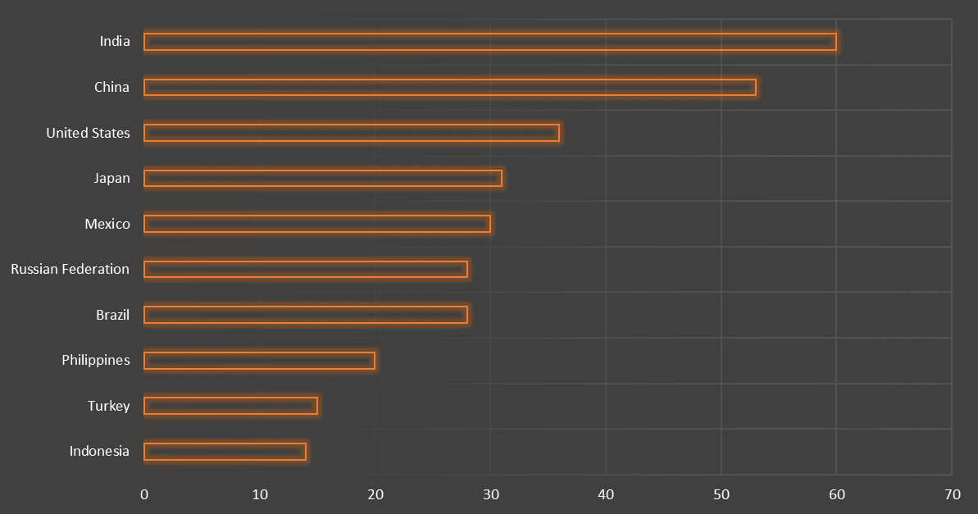
Top 10 Countries by Number of Customers

Slide 6
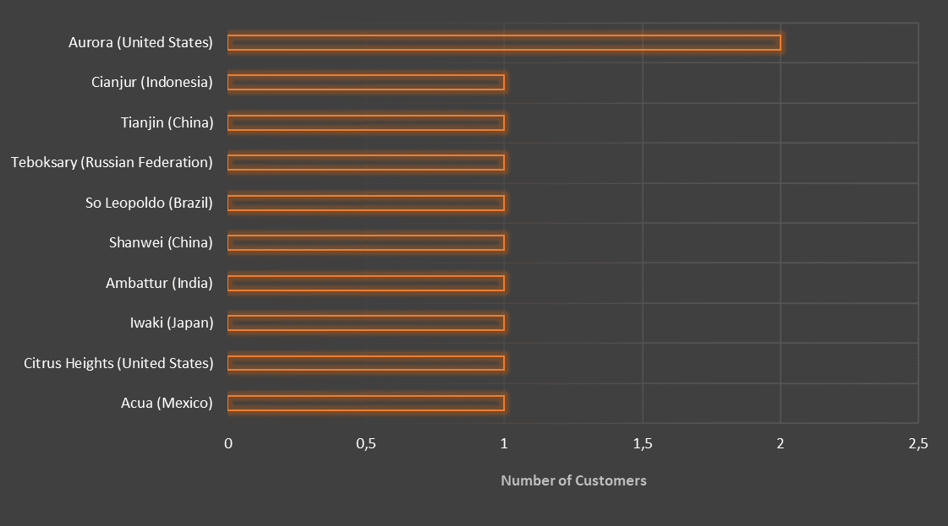
Top 10 Cities within Top 10 Countries
Only 1 city has 2 customers (Aurora), the rest have only 1 customer.

Slide 7
Top 5 Customers within Top 5 Cities
Are the countries where customers with the high lifetime value are based.

Slide 8
More about Countries with the High Lifetime Value Customers
Drama is the most popular category in China and Japan.
Susan Davis is the most popular actor in China and Japan.
The average length of films in these countries is between 113 – 116 minutes.
Films with mpaa rating ‘PG-13’ are the most popular among all these countries.
Trailers are the most common special features in China, Mexico and US.
Behind the Scenes are the most common special features in China, India and Japan.

Slide 9
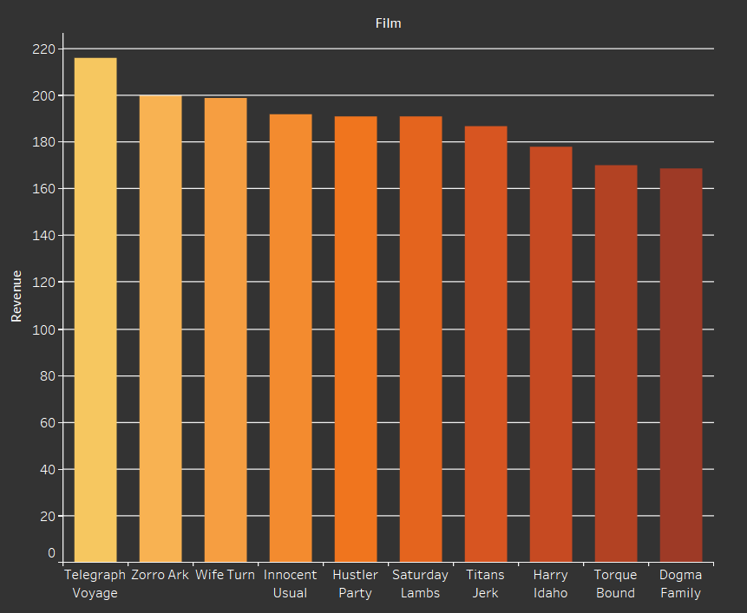
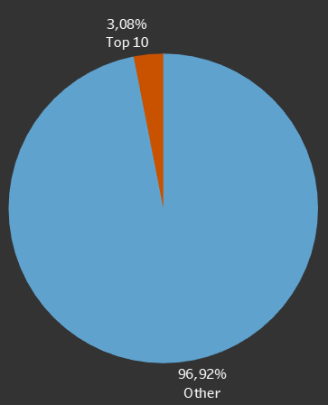
Top 10 Films by Revenue
The Top 10 films make up for only 3.08% of the total revenue.

Slide 10
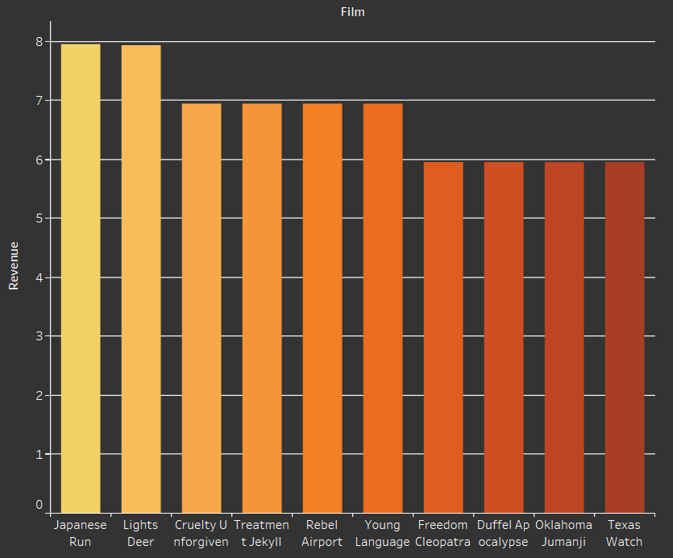
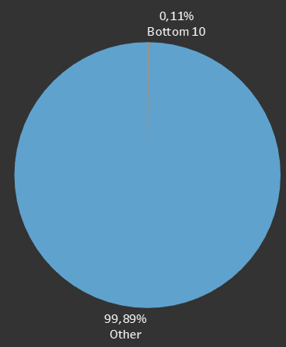
Bottom 10 Films by Revenue
The Bottom 10 films make up for 0,11% of the total revenue.

Slide 11
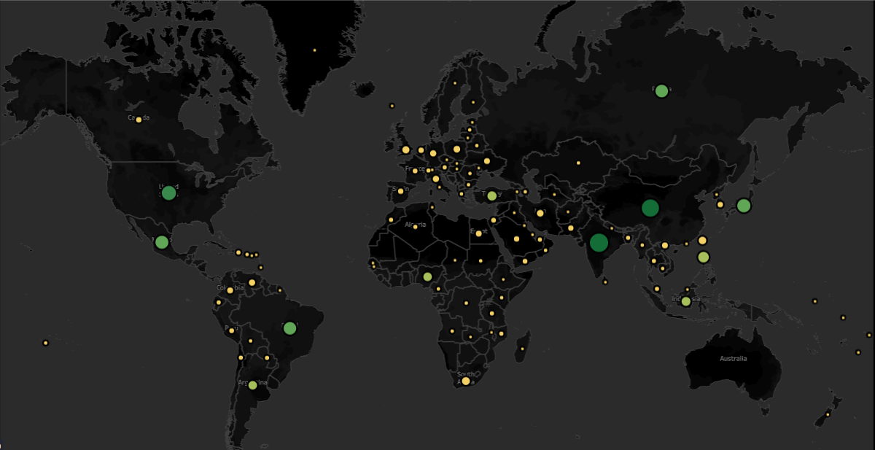
Customers and Revenue by Country
Size of a circle represents number of customers.
Color of a circle represents a revenue.
Lowest
Greatest

Slide 12

Recommendations
Top 10 Films by the revenue only make up for 3.08% of the total revenue, thus the company should not focus on them.
The company should focus on countries with high lifetime value customers, such as China, India, Japan, Mexico and US.
Among all those countries, the most rented films have ‘PG-13’ mpaa rating, so the company must have enough of those movies in the inventory.
Average length of all the rented films in those countries is 113 – 116 minutes. The company should push films of such a length, within a timeframe of ± 15 minutes.
In China and Japan, the Drama category should be well covered with Susan Davies in the acting cast.

Slide 13

Recommendations
Even though all rented movies are in English, maybe it would not be a bad idea for inventory department to provide films in native languages of the mentioned countries.
Make sure to supply enough of films with Action category in India, Sports category in Mexico and Documentary category in US.
Run advertising campaigns in these countries accordingly to the findings.

Slide 14

Thank you for attention.
Tableau Visualization Link

